Slide 1
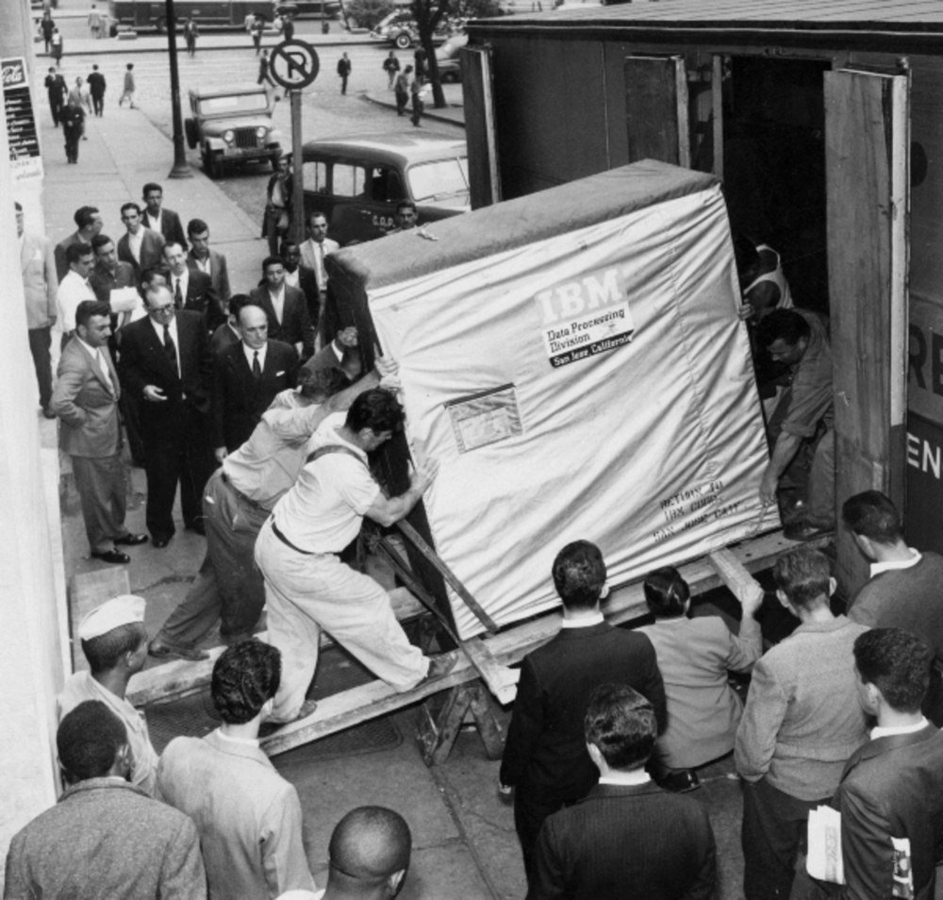

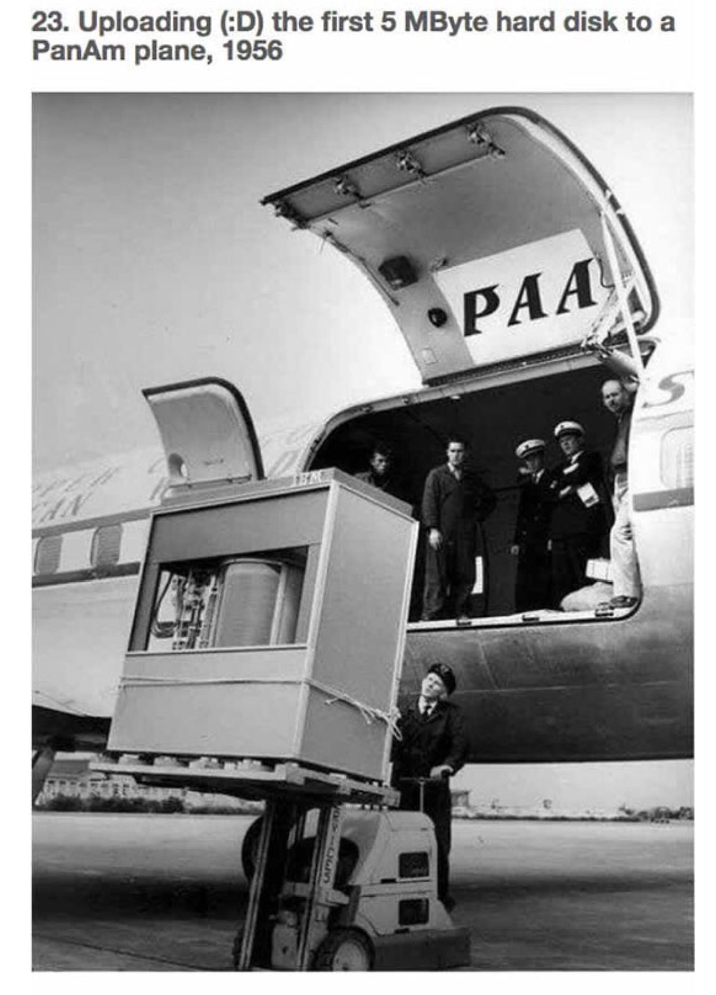
Machine learning for policy analysis
John Brandt
Notes:
This summer I have been considering the applications of machine learning to policy analysis and other work that involves text as data. As you can see in the background image, nobody considered using computers to analyze text in 1956 when a single high quality PDF would take a forklift to move. Today, with the ability to store thousands of PDFs in your pocket, it’s worth re-approaching the utility of computers in the research workflow.

Slide 2
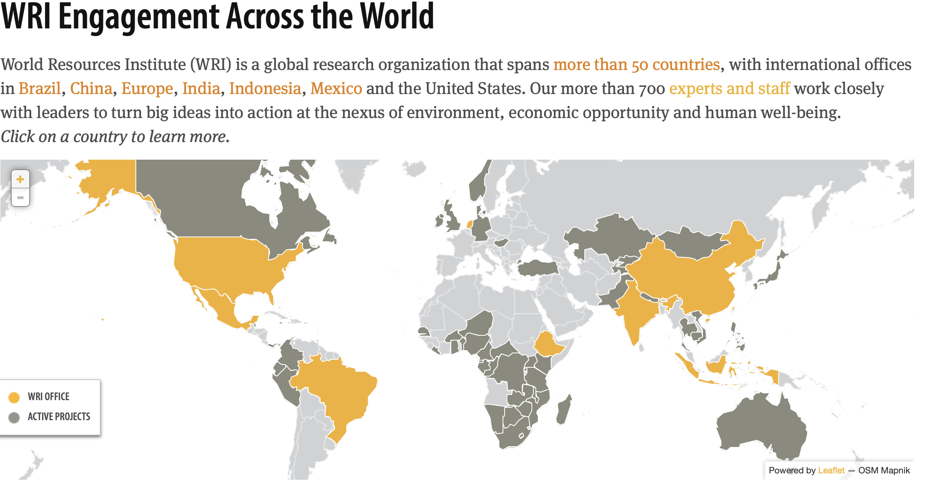
About WRI

Slide 3
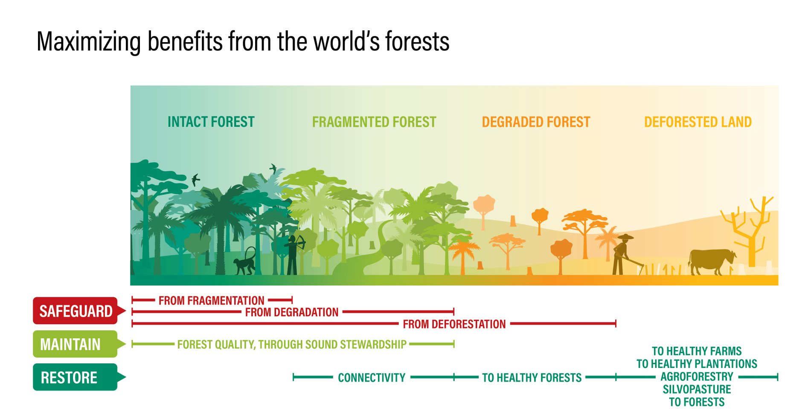
WHAT IS RESTORATION?

Slide 4



Slide 5



Slide 6



Slide 7
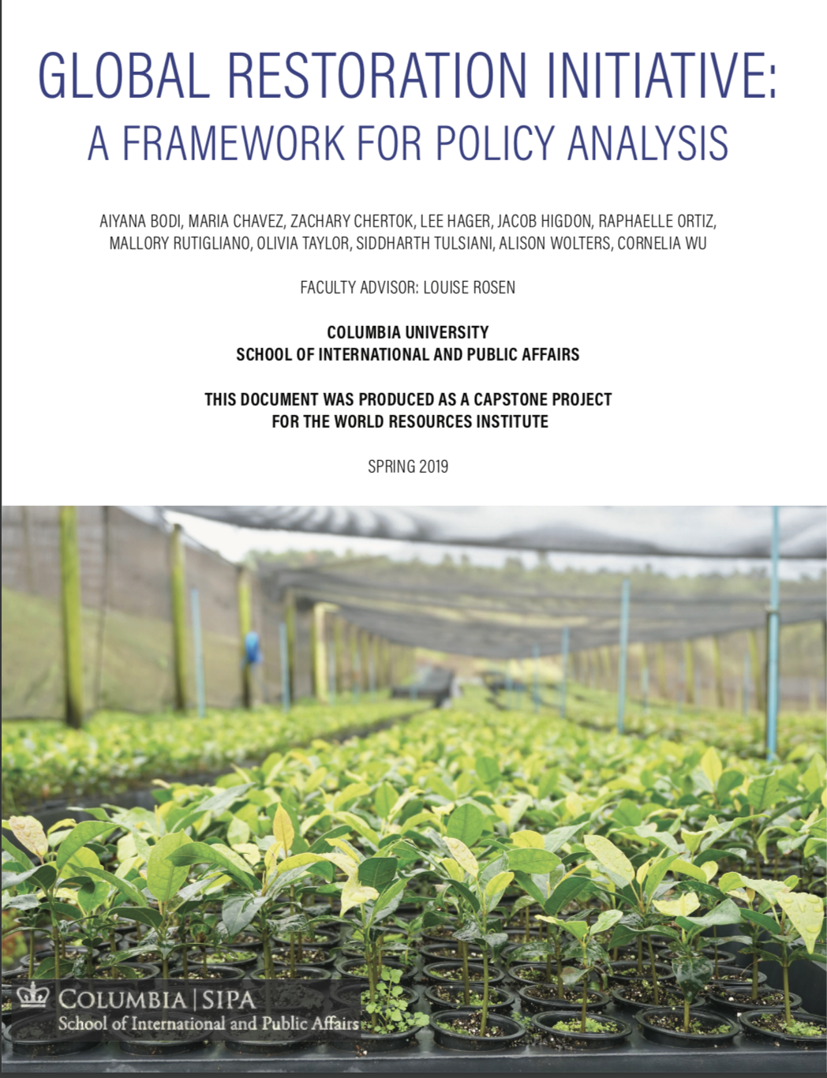

Slide 8
How do we analyze policy?
Broader Research
Objectivity
Transparency
Documents
Reproducability
Quantitativeness
Notes:
As we begin to ask broader questions about environmental movements, we simply have to digest more information. This scalability is traditionally limited by a few factors.
One of these is
Objectivity - Do Jane and Joe look at these documents the same way?
Transparency - Why did Intern Jane rank Country X higher than country Y 4 years ago?
Replicability - Why can't I press a button on Jane and have her repeat the analysis on these new documents in the same way?
Qualitativeness - How do I put a number on this?

Slide 9
Restoration
Land Policy
Mining Policy
Forestry Program
Environmental Management Act
Forest Act
Green Economy Strategy
Growth and Development
Wildlife Conservation
Food Security Action Plan
Livestock Policy
Natural Resources
Water Act
Agricultural Policy
Forest Landscape Restoration Policy
National Environmental Policy
Climate Change Policy
Land Tenure Policy
Long term plan
Physical Planning Bill
Notes:
The foundation for this project is in the Restoration team, because restoration is an umbrella term. It shows up in policy documents ranging from Land to Development to Mining to Forests to Water to Agriculture. This broadness makes ask policy-driven questions about restoration very difficult.

Slide 10

Can natural language processing standardize and expedite policy research while improving reproducibility and transparency?
Notes:
I spent my summer answering the question of whether natural language processing can standardize and expedite...

Slide 11
Can natural language processing help individuals understand what financing is available for sustainable development?
Notes:
I spent my summer answering the question of whether natural language processing can standardize and expedite...

Slide 12


Slide 13

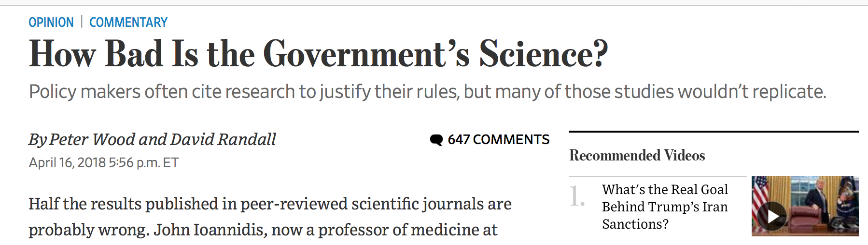



Notes:
28 Billion on preclinical trials – nonreproducible

Slide 14
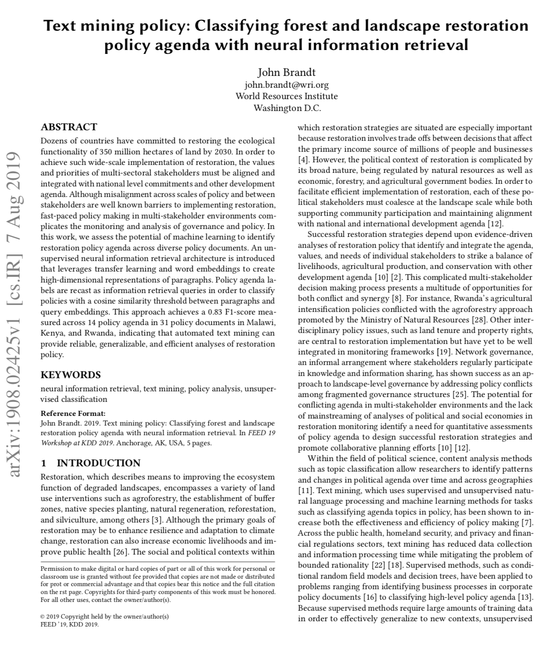
The first approach
Recast problem as semi-supervised neural information retrieval
Classes become keyword queries
Paragraphs ranked by cosine similarity, top-n chosen by supervision
Presented at KDD 2019
83% F1 at document level for 14 policy agenda

Slide 15
Workflow
Extract Text
Neural Embeddings
Query
Analyze results
Notes:
The process begins by extracting text from PDFs or websites. To do this, I use optical character recognition and page layout analysis. These forms of computer vision identify columns, figures, tables, and bodies of text and translate them into plain text. Focus on figure on the right

Slide 16
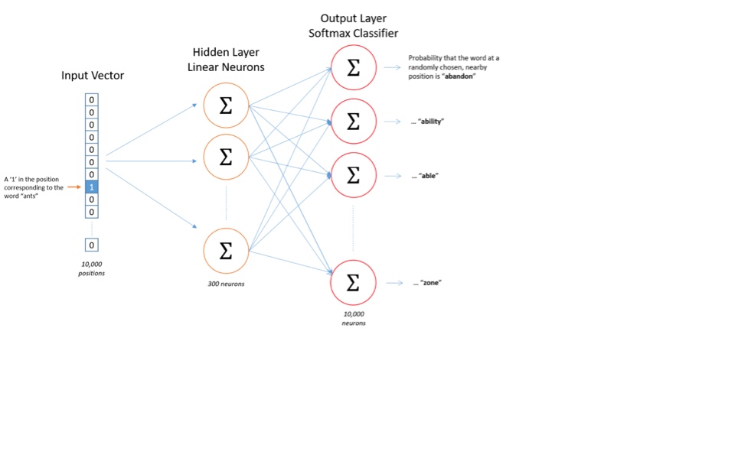
Workflow
Extract Text
Neural Embeddings
Query
Analyze results
Notes:
This shows a general structure of how neural word embeddings work. The idea is to consider each word in every sentence in every document. Remove each word one by one, and then build a neural network that tries to use the surrounding words to predict the missing word.
We care about the neural weights and not the predictions. The idea is that similar words have similar weights, because the weights are simply made up of some representation of the context of those words. "governance" and "regulatory" will have similar weights, while "governance" and "irrigation" will not.

Slide 17
Workflow
Extract Text
Neural Embeddings
Query
Analyze results
Notes:
Here, we can see that if you take the weights for "king", add "woman", and subtract "man", you end up with "queen"
Important: This is just done with neural weights that learn the context of the words!

Slide 18
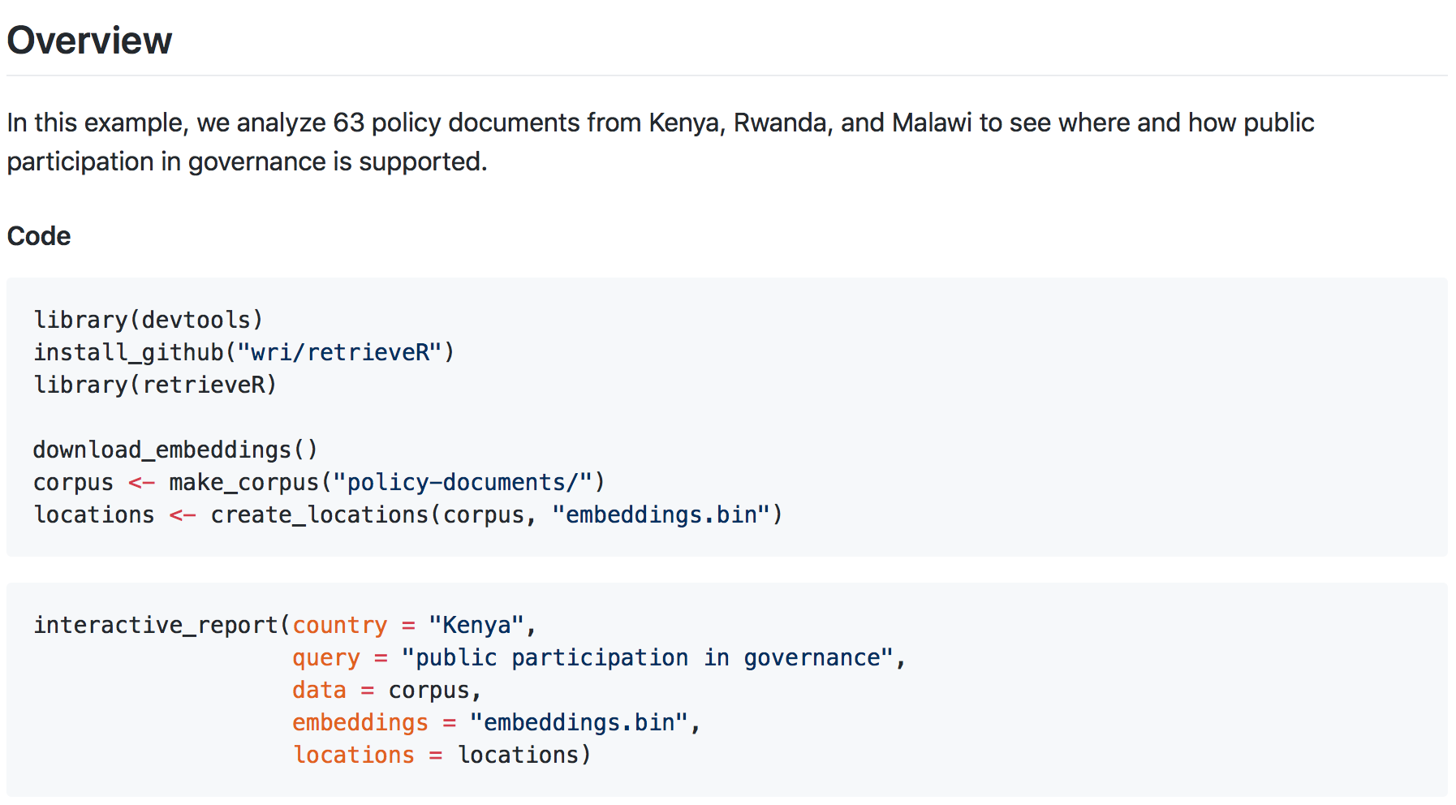
Workflow
Extract Text
Neural Embeddings
Query
Analyze results
Notes:
Here is the code, from installation to final product, involved in querying a set of documents

Slide 19
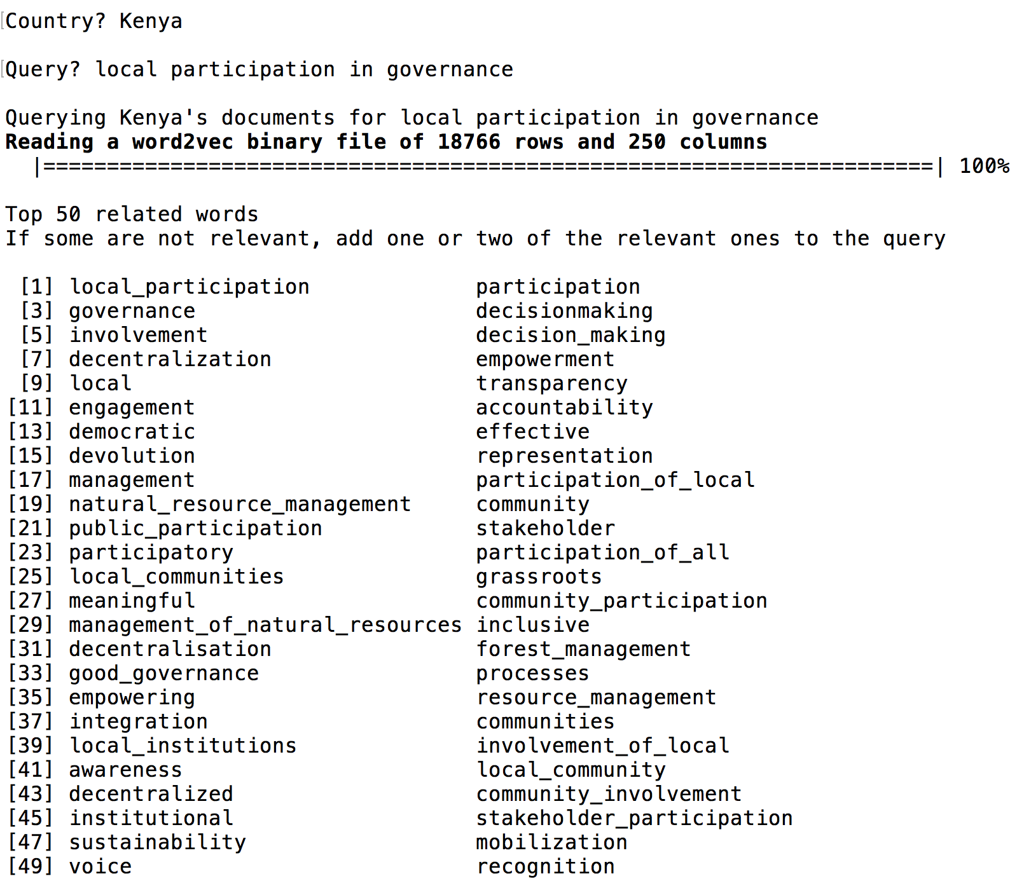
Workflow
Extract Text
Neural Embeddings
Query
Analyze results
Notes:
The figure here shows related words – close in hyperspace – to the query “local participation in governance”. The takeaway is that the algorithm learns that “decentralisation”, “democratic”, “devolution”, “empowerment”, etc are all similar phrases.
The query process is interactive, and users are allowed to add or remove words at this stage. Easier to draw plane with 8 points than with 3.

Slide 20
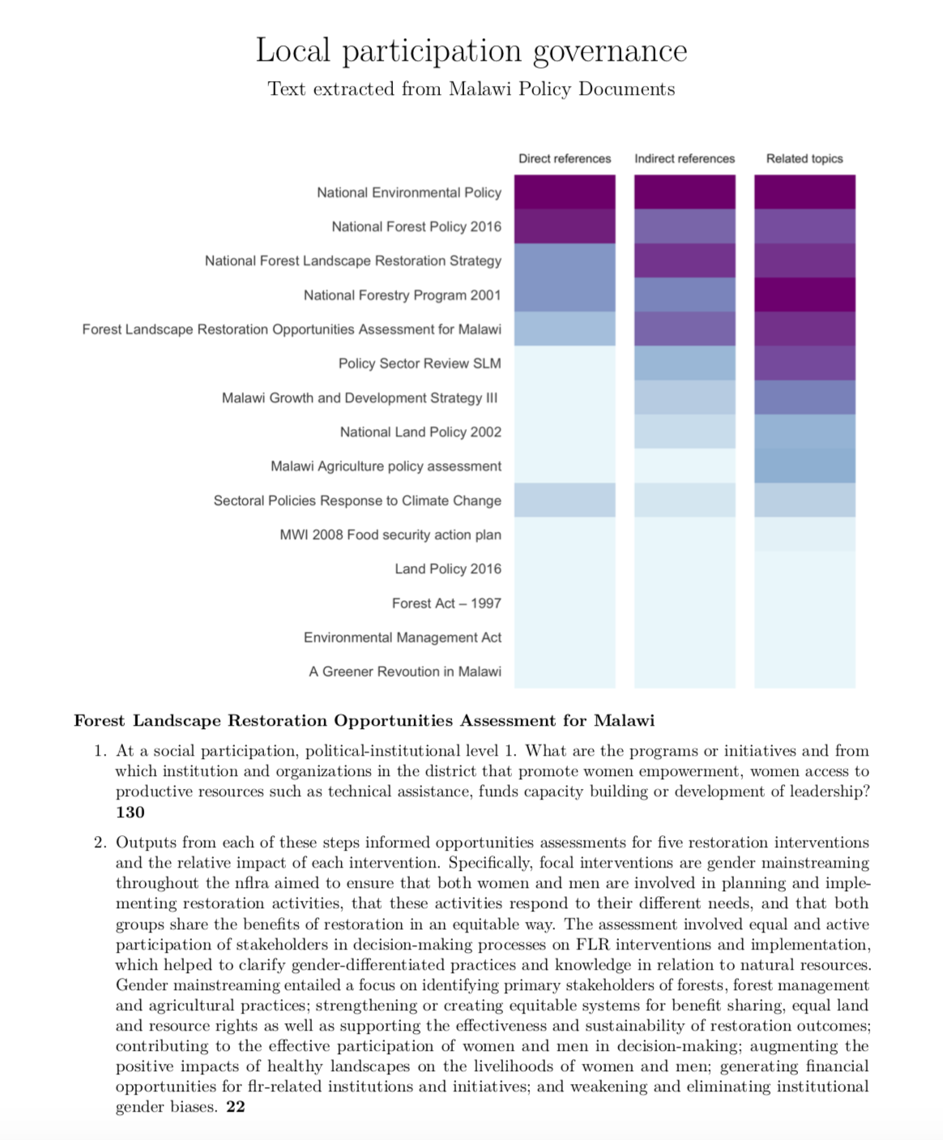
Auto-generated report
Heat map of the most important documents
Every relevant paragraph indexed by page number and document

Slide 21
What’s next?
Information retrieval classification
Gold standard
Noisy labels
Multi-task training
Web scrape new policies
Inform decision making

Slide 22

Use cases
Internal policy research
Identifying agenda
Setting agenda
Analyzing policy effectiveness
Identifying policy misalignment
Capacity building
Connecting stakeholders with relevant information synthesized across policies
Bridging the “information gap” that is a barrier to restoration finance

